Slide 1
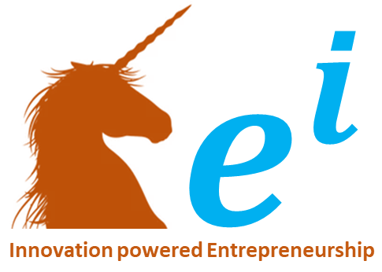





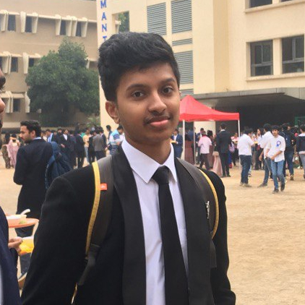
Students in Tier-2 and Tier-3 cities lack exposure to diverse career opportunities beyond traditional fields like engineering and medicine
CSE_H_485_479_489_472_909
Rithvik Matta
PES2UG23CS485
Rishi A Sheth
PES2UG23CS479
Rohan Jogi
PES2UG23CS489
Ashish Pavan
PES2UG23CS472
Rahul Senthil
PES2UG23CS909

Slide 2
1. Problem Statement
Students in Tier-2 and Tier-3 cities lack exposure to diverse career opportunities beyond traditional fields like engineering and medicine.
Why is this a problem?
Existing platforms like Unacademy focus only on academic content and do not provide personalized career counseling.
Many students are unaware of scholarships, internships, and skill-building programs available to them.
Traditional career counseling is expensive, inaccessible, and not tailored to individual interests.
Who is affected?
High school and college students from Tier-2 and Tier-3 cities who have limited guidance on career choices.
How does this problem occur?
Lack of mentorship and awareness about alternative career paths.
Limited access to career advisors and interactive guidance platforms.
How big is the problem globally?
Millions of students face limited career guidance, especially in developing nations where digital career counseling is still emerging.
There is a growing demand for affordable and accessible career advisory solutions.

Slide 3
2. Existing solutions to the problem - Benchmark
Current career guidance platforms:
Unacademy, Byju’s → Focus on academics, not career matchmaking.
LinkedIn, Coursera, EdX → Offer skill development but lack career-specific mentorship.
Traditional career counseling → Expensive and not scalable.
Gaps in existing solutions:
Lack of personalized AI-driven guidance.
No interactive features like games and career simulations.
No real-time updates on scholarships, internships, and career trends.

Slide 4
3. Proposed solutions
CareerWay - AI-Powered Career Guidance & Discovery Platform
Features: ✅ AI chatbot talks to users like a mentor, understanding interests and aspirations. ✅ Provides a step-by-step roadmap to reach career goals. ✅ Career cards allow users to swipe and explore different professions. ✅ Recommends degrees, colleges, scholarships, and internships. ✅ Integrates career-related 2D mini-games for interactive learning.
Example of games:
Cybersecurity → Solve a simulated cyber-attack.
Mechanical Engineering → Build a working gear system.
Graphic Design → Create a poster in a timed challenge.

Slide 5
4. Market
Global Market Size:
The EdTech and career guidance market is growing rapidly, with AI-powered career counseling expected to reach $2.5 billion by 2030.
Our initial focus is India’s Tier-2 and Tier-3 cities, expanding later to other developing nations.

Slide 6
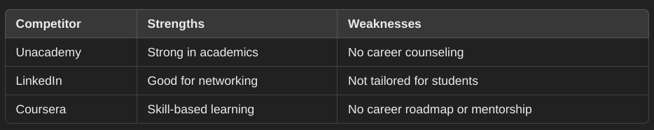
5. Competitive Landscape- Learn about competition – direct and indirect competition
Why CareerWay is Unique? 🚀 Combines AI, gamification, and interactive career exploration to make career discovery engaging and immersive.

Slide 7
6. Customer Discovery & Validation
Target Audience:
High school and college students from Tier-2 and Tier-3 cities.
Parents and teachers looking for career guidance tools.
Ed-tech companies looking for partnerships.
Customer Insights from Surveys & Interviews:
75% of students felt overwhelmed by career choices and wanted personalized guidance.
60% of students were unaware of scholarships and internships in their field.
82% said traditional career counseling was too expensive or unavailable in their area.
70% of students preferred a gamified career exploration over reading career guides.
Pilot Testing Feedback:
Users loved the swipe-based career cards for exploring options.
AI chatbot felt more engaging than traditional forms or static career tests.
Mini-games helped students experience careers firsthand, making them more confident in their choices.

Slide 8
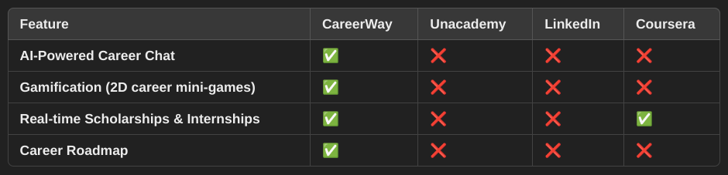
7. Value Identification
Unique Value Proposition: 🚀 AI-powered career guidance that’s engaging, interactive, and personalized. 🎮 Gamified career exploration through career mini-games. 🎓 Real-time updates on scholarships, internships, and industry trends. 💬 AI chatbot mentor that makes career discussions intuitive.

Slide 9
8. Product positioning
Market Category:
AI-powered Career Discovery & Guidance platform.
Tagline: 🛤️ The right way to the best career for you!
How CareerWay Stands Out: ✅ Fun & interactive career discovery (not just passive content). ✅ Personalized AI-driven recommendations (not one-size-fits-all career lists). ✅ Affordable & scalable career counseling (compared to costly in-person advisors).

Slide 10
9. Desirability , Feasibility & Viability
💡 Desirability (Do students want this?)
Strong survey validation shows students want a more interactive, AI-powered way to explore careers.
Early testers found the career cards, chat-based guidance, and games engaging.
🛠 Feasibility (Can we build it?)
Tech stack is clear → React.js, Node.js, OpenAI API, Firebase, MongoDB.
AI chatbot and recommendation system are implementable using existing ML models.
2D game development is possible using Unity, Phaser.js, or Godot.
💰 Viability (Can it sustain as a business?)
Freemium model ensures mass adoption with a clear subscription upgrade path.
Ed-tech partnerships provide monetization through integrations & course promotions.
Ad-based revenue from universities and online course platforms.

Slide 11
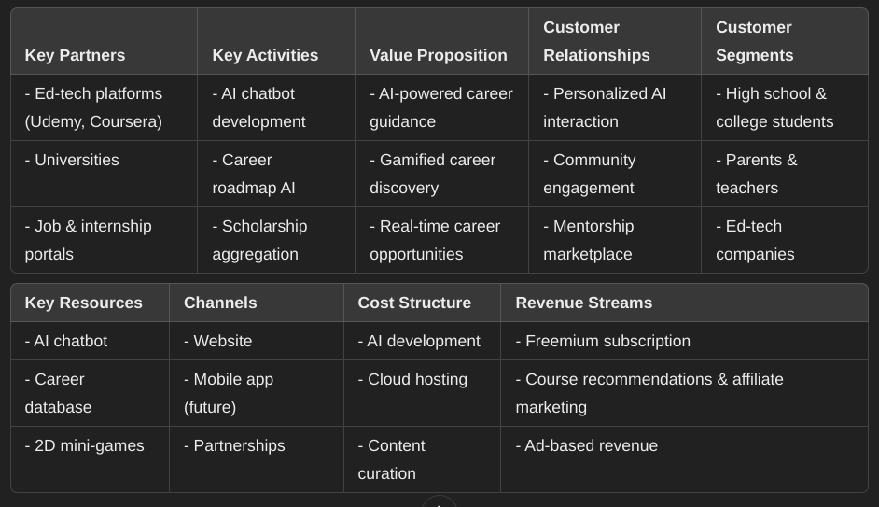
10. BMC – One pager

Slide 12
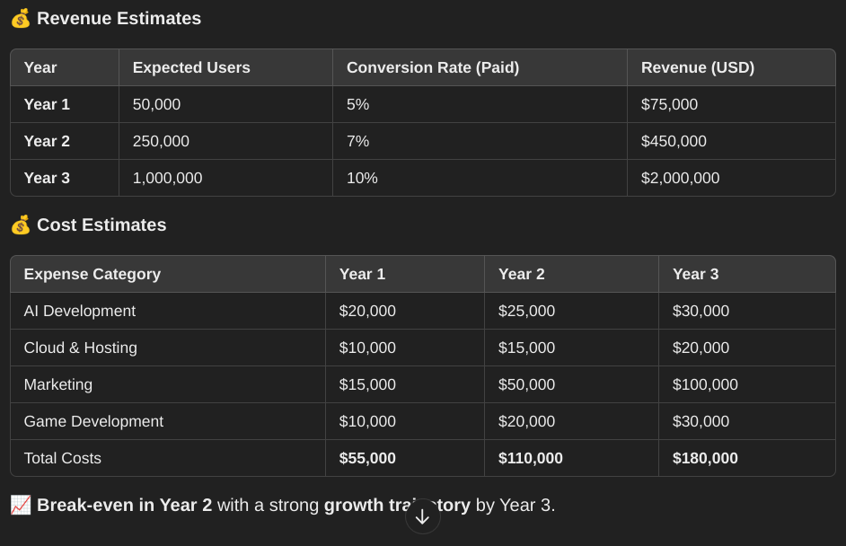
11. Financials projected

Slide 13
12. What support do you need to get ahead / forward from here ?
🚀 Funding & Investment
Initial funding to scale AI chatbot, develop gamified experiences, and expand scholarship tracking features.
🤝 Partnerships
Collaborations with ed-tech platforms (Udemy, Coursera, UpGrad) for course recommendations.
Tie-ups with universities and career coaches for mentorship integration.
Job platforms (Internshala, LinkedIn, Indeed) for real-time internship listings.
💡 Technical Support
AI optimization for better career recommendations.
Game development expertise to make career exploration fun and interactive.
📢 Marketing & Outreach
Social media awareness campaigns to attract students.
Webinars and partnerships with schools/colleges.
Influencer marketing (YouTube, LinkedIn, career counselors) to spread awareness.

